Slide 1
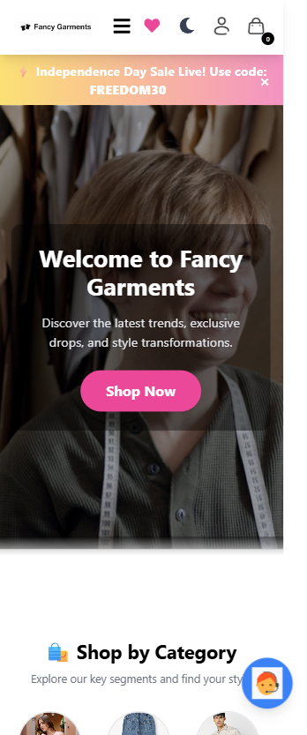
Fancy Garments
A Complete MERN Stack E-Commerce Solution
A full-featured fashion e-commerce platform featuring user shopping capabilities, secure payments, and an intuitive admin dashboard for comprehensive store management.

Slide 2
Technology Stack
Built with modern JavaScript technologies for seamless development and optimal performance.
Frontend
UI/Design
React + Vite for lightning-fast development and rendering
Tailwind CSS + styled-components for responsive, modern interfaces
Backend
Database
Node.js + Express for robust server-side logic and API endpoints
MongoDB + Mongoose for flexible, scalable data modeling
Payments
Media Storage
Stripe integration with Razorpay placeholder for secure transactions
Cloudinary + Multer for efficient image handling and uploads

Slide 3
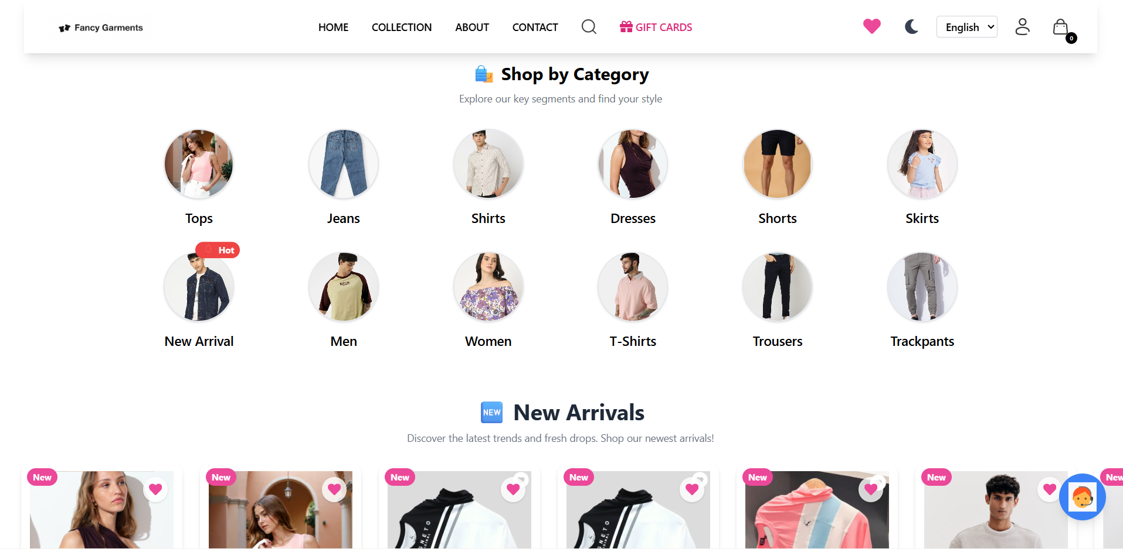

Slide 4

Project Architecture
A three-tier structure separating user interface, administrative controls, and data persistence layers.
User Storefront
src/ directory contains React components, pages, and ShopContext for state management
API Server
database/ houses routes, controllers, models, middleware, and configuration files
Admin Dashboard
admin/ provides separate React application for product management and order tracking
Media Storage
uploads/ directory stores images temporarily before Cloudinary processing

Slide 5

Backend API Structure
Core Components
API Endpoints
The API entry point at database/server.js establishes connections to MongoDB and Cloudinary, then serves routes and static assets.
/api/user — User authentication and profile management
/api/product — Product catalog operations
/api/cart — Shopping cart functionality
/api/order — Order processing and tracking
/api/wishlist — Wishlist management
Images are served directly from the uploads/ directory, providing fast access to product media.

Slide 6
Security Implementation
JWT Authentication
Protected Routes
JSON Web Tokens stored in localStorage provide session management with 24-hour expiration for enhanced security
Middleware validates tokens and sets req.userId for authenticated requests, ensuring data privacy
Admin Protection
Password Security
Separate adminAuth middleware protects sensitive endpoints from unauthorized access
Bcrypt hashing ensures passwords are never stored in plain text, protecting user credentials

Slide 7
Data Models
MongoDB collections designed for efficient querying and flexible data relationships.
User Model
Product Model
User information, cart data, profile images, and authentication details stored in a single document for quick access
Product details, four image URLs, available sizes, category classifications, and pricing information
Order Model
Wishlist Model
Order items, total amounts, shipping addresses, payment status, and delivery tracking fields
User wishlist items supporting both products and video content with flexible schema design

Slide 8
Storefront Features
01
02
Browse & Discover
Product Details
Explore home page and curated collections with responsive product grids
View comprehensive product information at /product/:productId with size selection
03
04
Cart Management
Wishlist Functionality
Add to cart, adjust quantities, and manage items with real-time updates
Save favorites with add/remove actions and dropdown preview capability
05
06
Secure Checkout
Order Tracking
Choose Cash on Delivery or Stripe payment with order placement at /api/order/place
Monitor order status and download invoice PDFs for record keeping

Slide 9
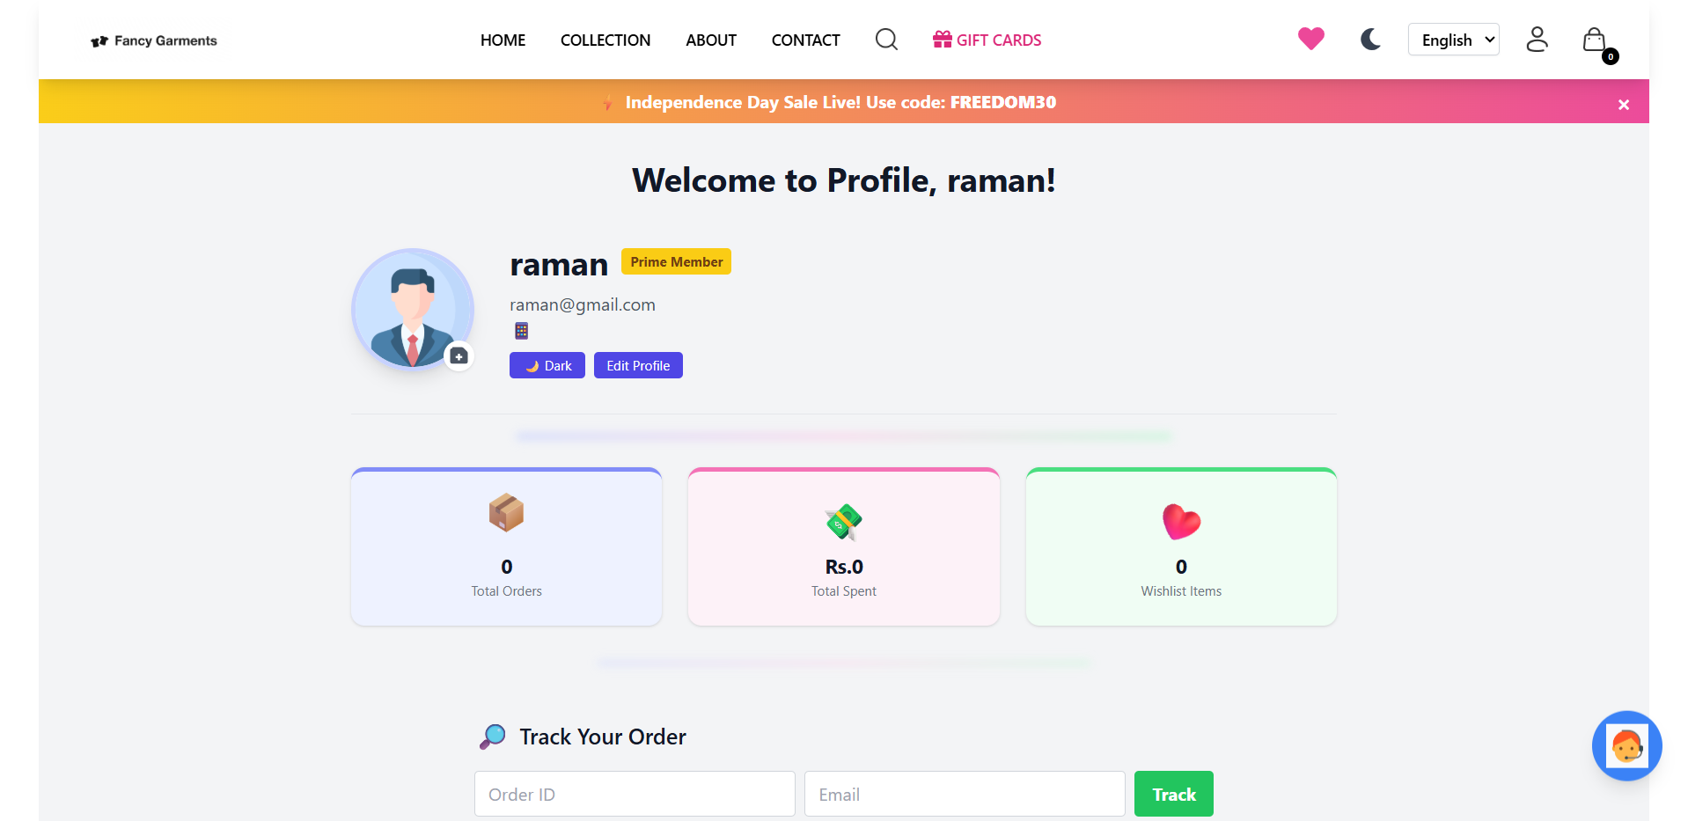

Slide 10

State Management
ShopContext — Centralized State Layer
Core State Elements
Backend Synchronization
cartItems — Current shopping cart contents
products — Product catalog data
token — JWT authentication token
userData — User profile information
wishlist — Saved items collection
Context functions handle API calls automatically, eliminating duplicate logic across components.
Fetch products on initial load via GET /api/product/list
Cart operations: add, update, get
Wishlist operations: add, remove

Slide 11




Checkout & Payment Flow
Stripe Integration End-to-End Process
Order Placement
User initiates checkout from PlaceOrder.jsx component
Session Creation
Backend generates Stripe Checkout session in placeOrderStripe controller
User Redirect
Stripe handles payment collection and redirects to Verify.jsx with session data
Verification
POST /api/order/verifyStripe updates payment status, sets delivery to processing, and clears cart

Slide 12
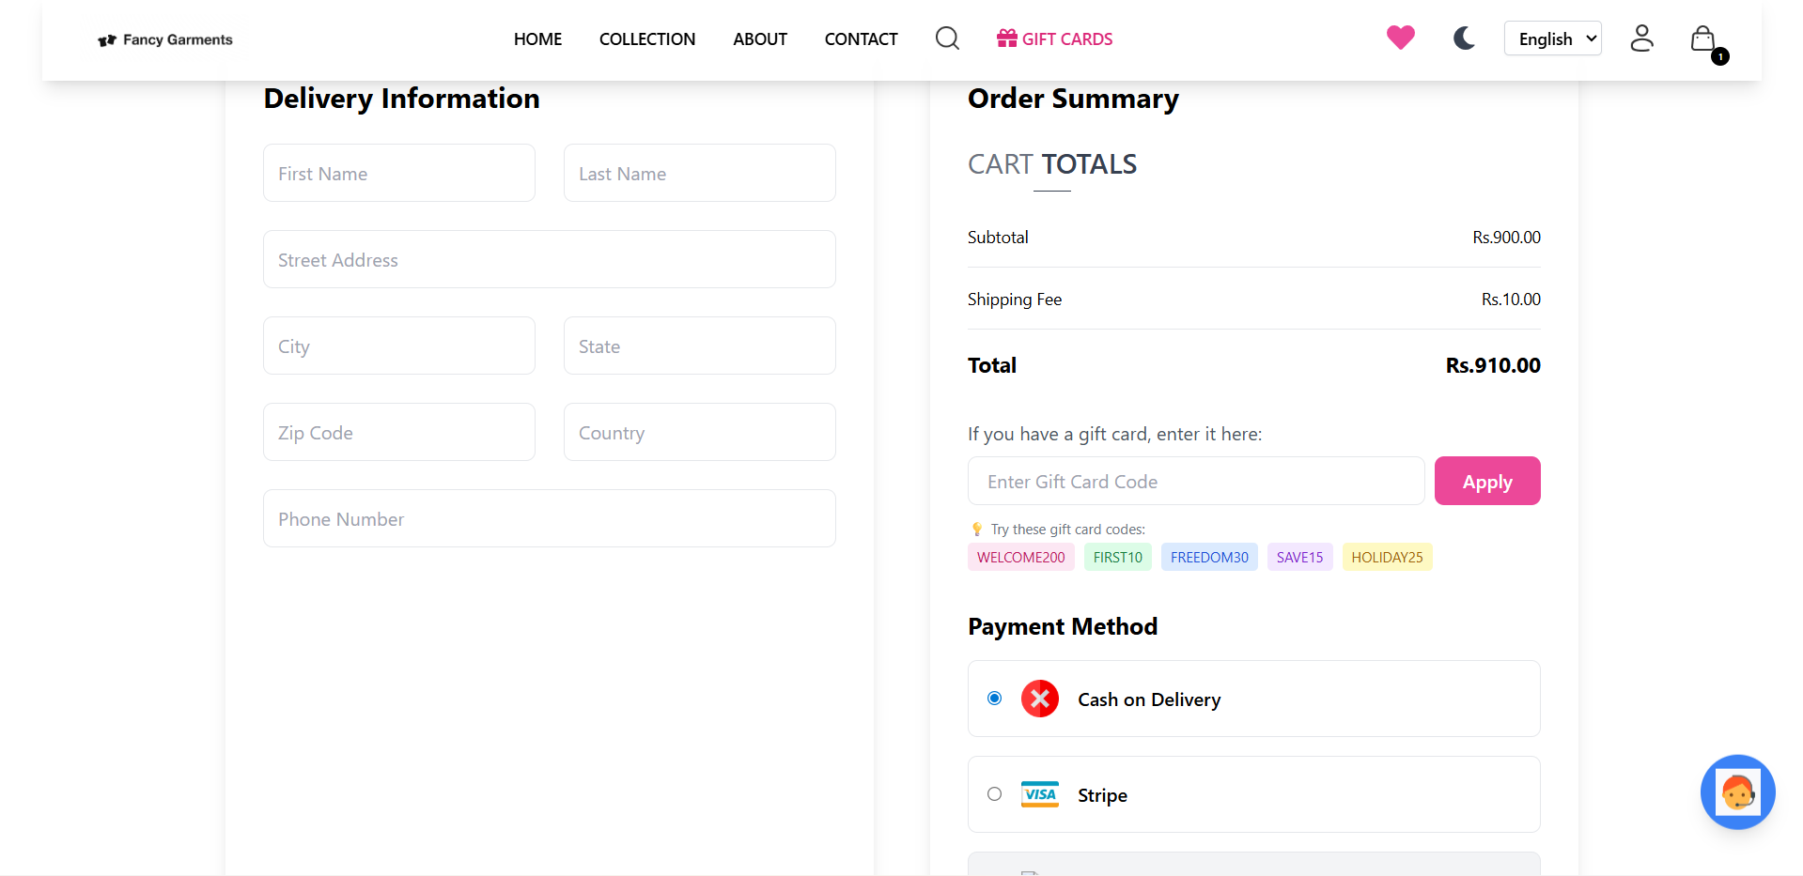

Slide 13
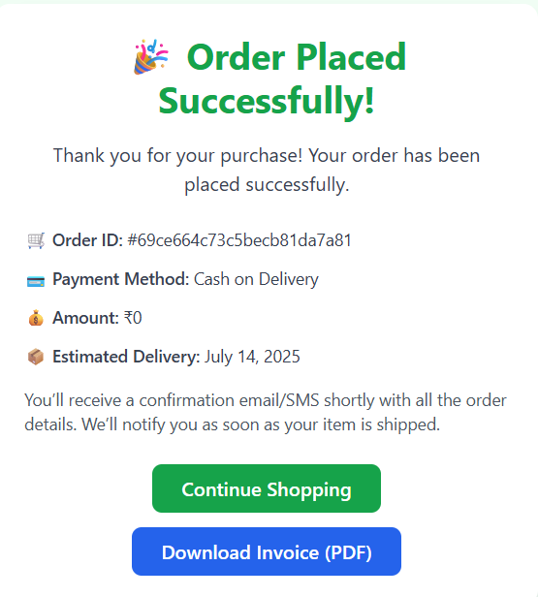
Orders & Invoices
Orders Page Functionality
Orders.jsx loads user orders via POST /api/order/userorders, displaying status progress and timeline UI.
Available Actions
Download Invoice — Client-side PDF generation using html2pdf.js and jsPDF libraries
Email Invoice — API call to /api/order/send-invoice for delivery notification
Cancel Order — Modal opens for reason input, then POST /api/order/cancel updates status

